Slide 1
Aviva Brand registration process - for use of Communities Fund and Future Finances Fund assets

Slide 2


Aviva Foundation brand assets
In response to feedback from the causes we support, we’ve created a branded asset for projects that have successfully received Aviva funding.
If your charity would like to acknowledge their involvement in either the Communities Fund or Future Finances Fund, this guide shows you how to request access to download the asset and then the process for seeking approval on how and where you’d like to use it.
We anticipate you might want to use this on things like email signature, website, impact report etc.

Slide 3
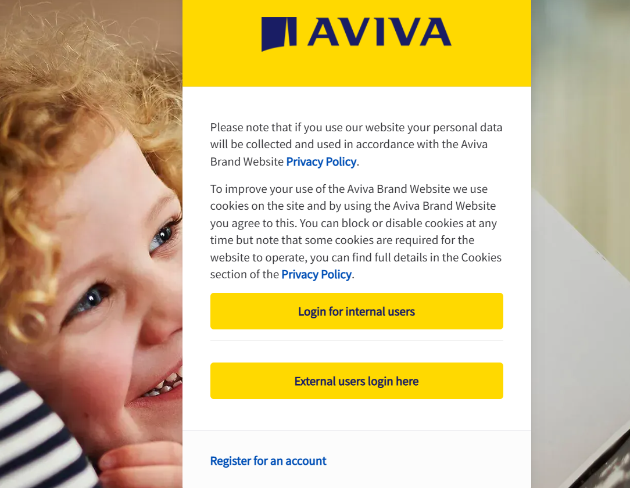
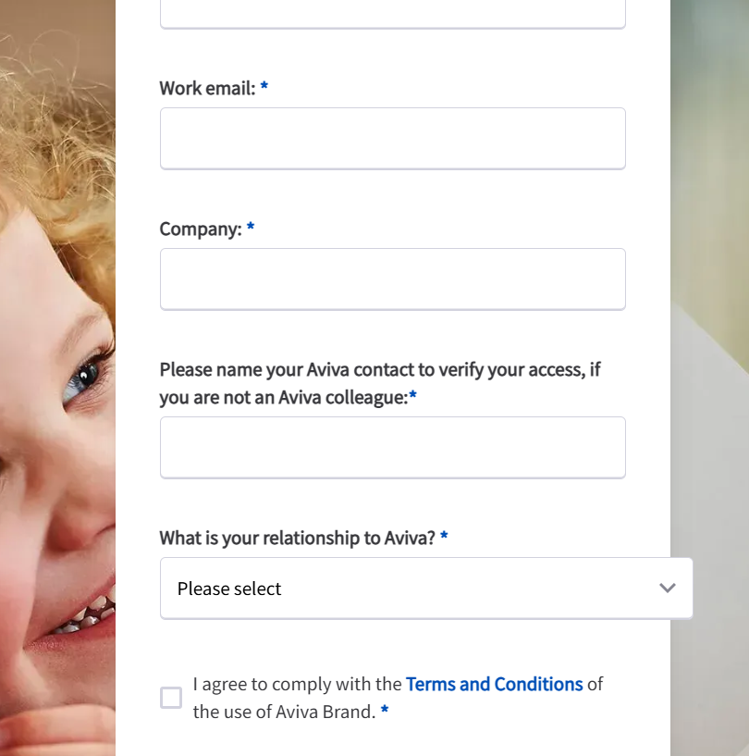
Step 1. Register for access on avivabrand.com
2) Complete the form using your charity or organisation information.
For Aviva colleague please enter Rebecca Turney
In the relationship to Aviva dropdown, select ‘External charity partner (needing Aviva Foundation assets)
Check the tick box to accept the T&C’s
1) Go to www.avivabrand.com and click Register for an account

Slide 4
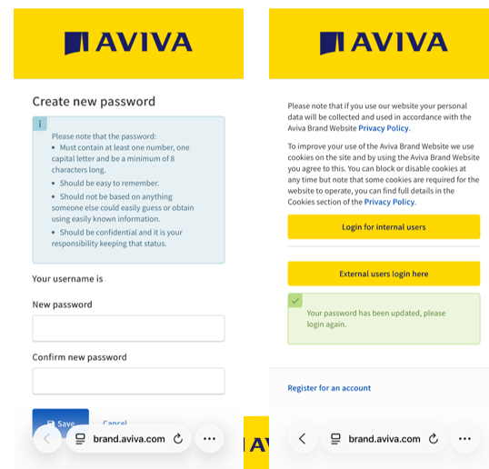
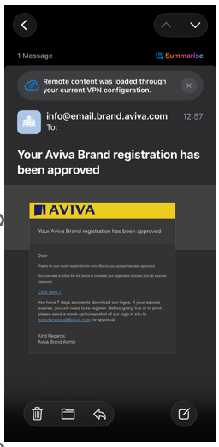
Step 2. Access avivabrand.com to download the asset
3) Your request to access avivabrand.com will be approved by Aviva within 5-7 working days. You’ll receive email notification that access has been granted.
4) You will be prompted to create a new password which you can then use to log in and download the asset you require. Note you have 7 days to log in and download the asset you require.

Slide 5


Step 3. Request Aviva brand approval
We have provided the assets in a variety of file formats depending on where you are using it. If in doubt, please use the JPG file.
Please select the correct asset depending on whether you’ve been supported by the Communities Fund or the Financial Futures Fund.
When ready, you will need to mock up the design showing how and where you will use the asset (e.g. how it will appear on your website or report). You will need to share this via email with the Aviva brand team who will give you approval or request a few changes if not quite right. The email granting you access to the Aviva brand site will explain these instructions.
Some do’s and don’ts
Keep the ratio of the asset if resizing – don’t stretch or distort the image
Keep the colours as they are – please don’t make black or white
Don’t add borders and keep a good amount of white space around the asset if using alongside other images and logos
The asset should not be cropped, broken up or edited in any way
Please don’t share the asset with others or use for purposes other than illustrating support from the Aviva Foundation
We anticipate this asset being used for no longer than 12 months after receipt of funding

